Slide 1
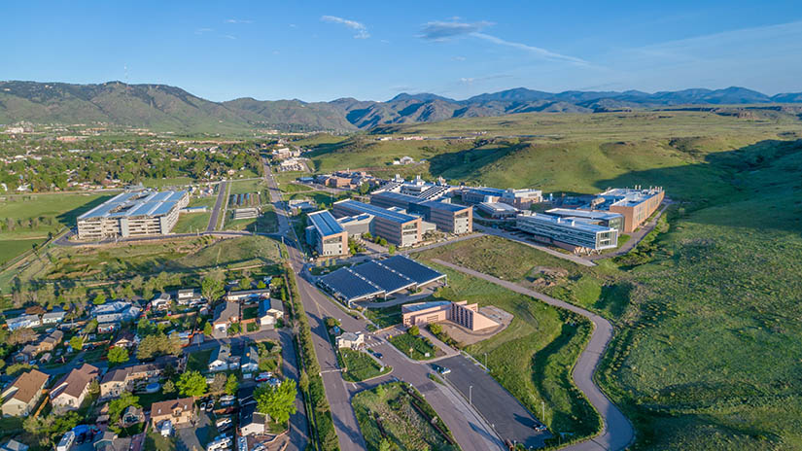
Greg’s Training

Slide 2
Greg’s Training

Slide 3
A
C
U
M
E
N
Alignment
Collaboration
Understanding
Measurement
Example
Needs

Slide 4
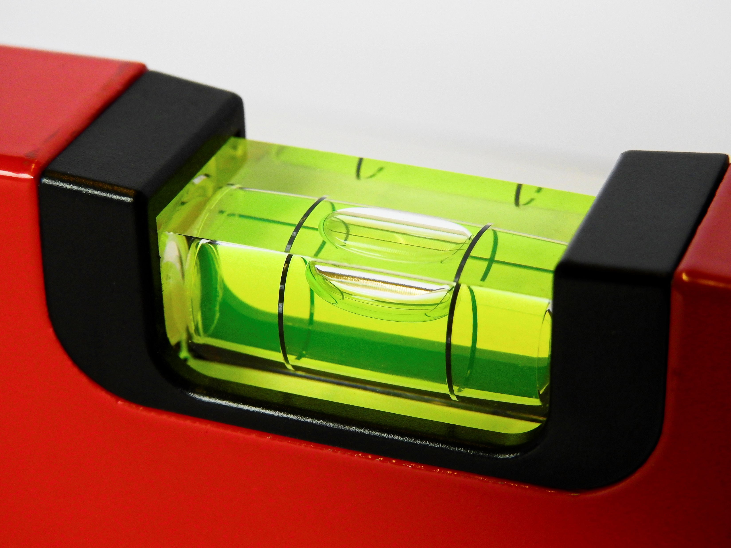
A
Alignment
Alignment with business needs.
As trainers our training must align with the needs of the business.
Alignment with our customer needs.
As trainers we may be the experts in our field, but we are not necessarily experts in our customer’s field.
Notes:
We create training with a purpose.
That purpose is to make sure that everyone on our team, and all our internal and external customers know how to do their job. To do that we must create alignment.
We may be experts in the field of training, but we are not always experts in the fields we are training. We need to create alignment with our SMEs, Stakeholders, and Customers.
We might have decided that the best way to train a particular topic might be an ILT class. But do we know the entire situation. Maybe there is not enough hardware. Maybe access to the software is limited. We need to align our need to our customers. Sometimes we compromise.

Slide 5
A
C
U
M
E
N
Alignment
Collaboration
Understanding
Measurement
Example
Needs

Slide 6
C
Collaboration
When we collaborate, we can:
Create coownership.
Create buy in.
Get a “Seat at the Table.
Notes:
When we collaborate, when we listen, we can create coownership.
When we create coownership, we can get a seat at the table and create value to training.

Slide 7
A
C
U
M
E
N
Alignment
Collaboration
Understanding
Measurement
Example
Needs

Slide 8
U
Understanding
We must understand:
Bias
Audience
Objectives
Notes:
Bias is a little word with a big meaning.
Everyone has one.
Not are necessarily wrong.
Bias is our center. Not everyone's bias is the same.
Bias can come from anything :
Culture
Upbringing,
Evolution.
The key is to understand your bias and try to understand other bias.
This will help us to understand our audience and how they learn and let us meet our objectives.

Slide 9
A
C
U
M
E
N
Alignment
Collaboration
Understanding
Measurement
Example
Needs

Slide 10
M
Measurement
We must measure, not just now but:
3 months
6 Months
A year
Training is not just an event but a process.
Notes:
In my career I have learned many things. And one of the most important is that training does not end. It is much more then a single event.

Slide 11
A
C
U
M
E
N
Alignment
Collaboration
Understanding
Measurement
Example
Needs

Slide 12
E
Example
Be the Example – Stand out
Prepare.
Don’t wing it.
Admit if you don’t know.
Create a safe learning environment.
Show up early.
Be available.
Notes:
Be the one that stands out.
We want to build relationships with our SMEs, Stakeholders, and Audience.
When you are the Facilitator.
Prepare for class.
Study the material
Do not wing it.
They can tell and it is a sure-fire way to lose an audience.
Be available.
Show up early.
Create a safe learning environment.
When you are the Instructional designer.
Be Flexible.
Ask Questions.
Show your value.

Slide 13
A
C
U
M
E
N
Alignment
Collaboration
Understanding
Measurement
Example
Needs

Slide 14
N
Needs
Needs Analysis:
This is what ties it all together.
A proper needs analysis will cover:
Current knowledge
Behaviors
Measurement
Audience
Objectives
KPIs
SWOTs
Anything else
Notes:
The Needs is the backbone of the training industry. If it is not done right the training can fail.
A prober need analysis will cover the current knowledge, behaviors, measurement, audience, objectives, KPIs, SWOTs, and pretty much anything else.

Slide 15
A
C
U
M
E
N
Alignment
Collaboration
Understanding
Measurement
Example
Needs
Alignment with business and customer needs.
Collaboration leads to coownership, leads to buy in.
Understanding your bias.
Measurement the student and the class
Be the Example.
Needs Analysis ties it all together.

Slide 16
Measurement

Slide 17
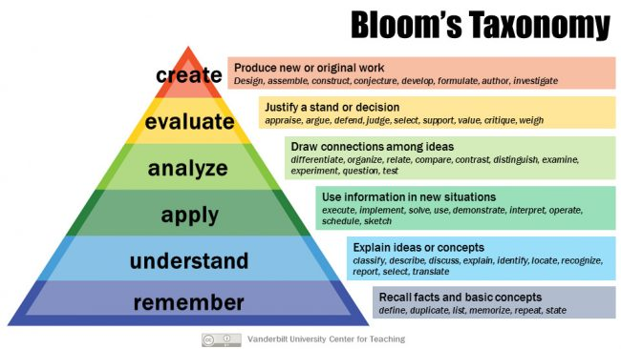
Measurement
Starts at the needs analysis.
Identify the behaviors and how to measure them.
I use Bloom’s Taxonomy for this:
Remember
Simple tests, multiple choice.
Understand
Explain to me.
Apply
The test might have the behavior done. Example: Assemble the equipment, clear the room.
Analyze
Troubleshoot scenario. Example: Find the weakness.
Evaluate
Scenario: Fix the weakness.
Create
Create a plan.
Notes:
Measurement starts at the needs analysis . It is the first stated in creating training. A lot of people do not understand that .
When the behaviors that need to be changed re identified it is at this point that you must consider how to measure them.
To determine this, I tend to use Bloom.
Remember – Simple tests, multiple choice.
Understand – Explain to me.
Apply – The test might have the behavior done. Example: Assemble the equipment,. Clear the room.
Analyze – Troubleshoot, scenario. Example: Find the weakness.
Evaluate – Scenario: Fix the weakness.
Create - Create a plan.

Slide 18
Measurement
The Kirkpatrick Model – 4 Levels of Training Evaluation
Reaction
The learner's initial reaction to the training.
Data is easy to get.
In-class test.
Learning
Degree to which the learner understood the content.
Behavior
Degree to which the training has been used on the job.
Much harder to get good data for a measurement.
Results
Degree to which company outcomes occurred.
Notes:
Kirkpatrick tells us there are 4 levels of evaluation.
Most companies are pretty good at measuring the first 2 ,Reaction and Learning.
These can be done with simple tests during the class. based on Bloom.
The behavior change and the results can be a little more difficult to measure. You do not always have the time or resources.
In my mind training is a process , not just an event.
How can you check behavior and results?
CRM cases.
Manager feedback.
Recertification.

Slide 19
Remember:
Measurement is not just to test the student but also ensures the training is addressing the behaviors and is working.

Slide 20
Behavior and Results
How can you check behavior and results?
Incident Reports
Customer feedback
Manager feedback
Peer feedback
Service calls
Self assessment
Recertification
Reaction
The learner's initial reaction to the training.
Learning
Degree to which the learner understood the content.
Behavior
Degree to which the training has been used on the job.
Results
Degree to which company outcomes occurred.
Notes:
Service calls

Slide 21
Passion For Training

Slide 22
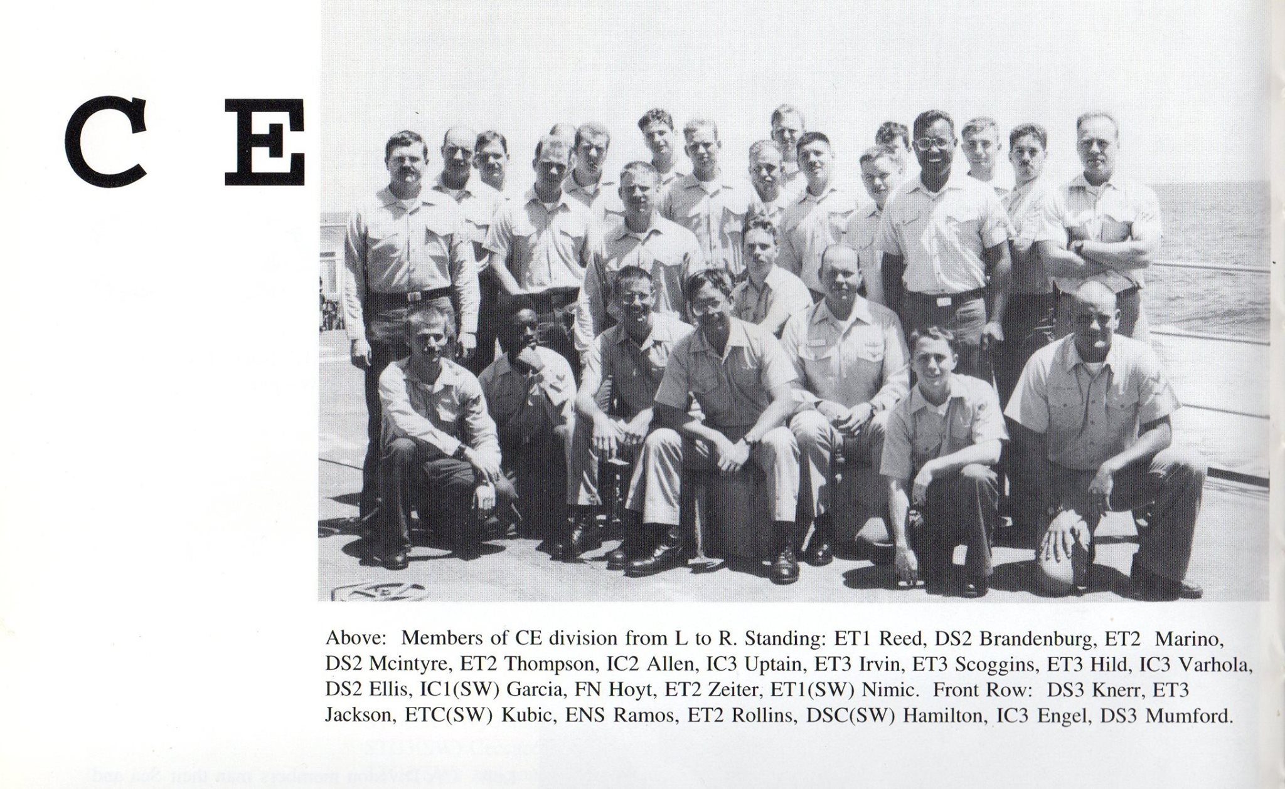
Work History
To understand where my passion for training comes from, we need to jump into my past.
I worked in mostly technical fields.
My first job was as an electronics technician 2nd class in the Navy.
Notes:
To understand where my passion for training comes from, we need to jump into my past.

Slide 23
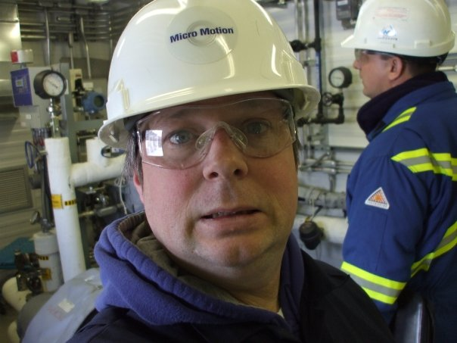
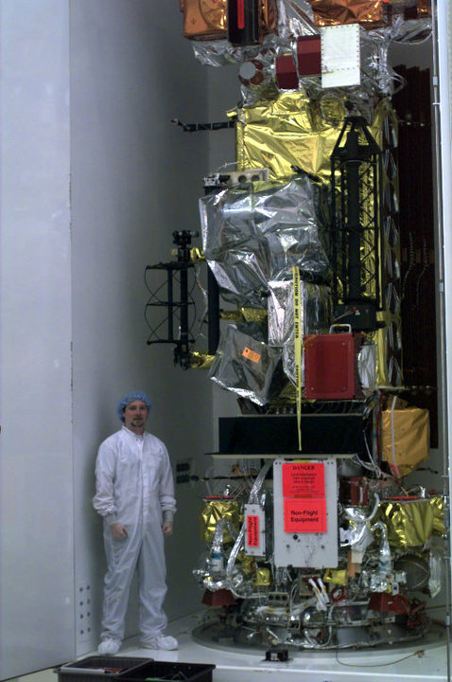
Work History
I have worked in Aerospace at Lockheed Martin Missiles and Space and Ball Aerospace as an Integration and Test technician
I worked at Emerson as an Electronics Tech and Customer service engineer.
Along with several other places.
TIROS NOAA M
Notes:
Shell Upgrader in Ft Saskatchewan just northeast of Edmonton Alberta.

Slide 24
Work History
While at Emerson my boss told me he thought I would be a good trainer and wanted me to teach Micro Motion’s comprehensive Mass Flow Coriolis product line.
This was a huge change in my career path and found my calling
Shell Upgrader Fort Saskatchewan Alberta Canada
Notes:
I found I was able to take complex ideas and format them into easy-to-understand chucks because of ny technical background.
But I also found that I enjoyed learning from my students and much as I love talking to them.
I quickly decided that this is what I wanted to do. and applied for a trainer position an Emerson and got it. I created my first training course for a company Emerson purchased called Mobrey.
After that I realized what I did not know and started to learn the ins and outs of the industry. Example: Someone asked me what Micro learning was….I think I know.
Like most trainers I love to learn, and I thrive in constant change, and I am flexible.

Slide 25
Training
Like most trainers:
I love to learn.
I pick up concepts quickly.
I thrive in constant change.
I adapt.

Slide 26
Questions?

