Slide 1
Technical Training
Greg Rollins
Lakewood, November 2021
Version 1.0
Notes:
This is a title slide.

Slide 2
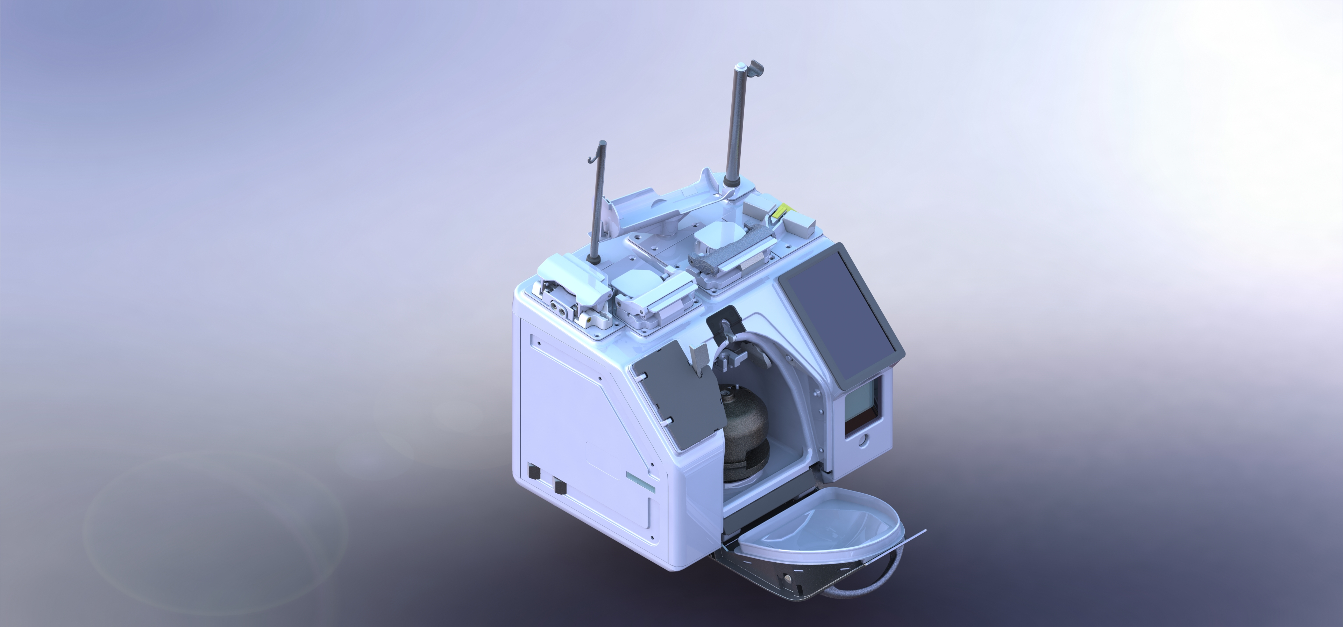
Welcome
What to expect
  The class will last 5 days. 8 AM to 5 PM
  Lunch and breaks
  Restrooms
  Food
Introductions
  What is your name and some background
Requests
  Make mistakes in class, not in the field
  Ask questions
  Give honest feedback
Notes:
Facilitator will let students know when and how many breaks there are. There should be at least one in the morning and one in the afternoon. While the times of the breaks may shift please make sure brakes are given.
Facilitator will also tell students the locations of restrooms and lunch options.
Introductions should start with the facilitator.

Slide 3
Agenda
Day 1
  Introductions
  Rika Overview
  High-Pressure and Cuff discussion and workshop
  AC Pump assembly discussion and workshop
  Power System discussion and workshop
Day 2
  Review
  Draw and Return Pump assembly discussion and workshop
  Soft Cassette Housing assembly discussion and workshop
  Dual-Valve / Beacon / Weight Station assembly discussion and workshop
Day 3
  Review
  Centrifuge and Centrifuge Chamber assembly discussion and workshop
Day 4
  Control System / STS discussion and workshop
  Service Message discussion
  Troubleshooting discussion
  Troubleshooting fault exercises
  IQ/OQ/PQ
Day 5
  Overflow
  Review and Test
Notes:
Agenda
Day 1
Introductions
Rika Overview
High-Pressure and Cuff discussion and workshop
AC Pump assembly discussion and workshop
Power System discussion and workshop
Day 2
Review
Draw and Return Pump assembly discussion and workshop
Soft Cassette Housing assembly discussion and workshop
Dual-Valve assembly discussion and Workshop
Day 3
Review
Weigh Station discussion and workshop
Centrifuge and Centrifuge Chamber assembly discussion and workshop
Day 4
Control System discussion and workshop
Service Message discussion
Troubleshooting discussion
Troubleshooting fault exercises
IQ/OQ/PQ
Day 5
Overflow
Review and Test

Slide 4
Course Objectives
Upon completion of this course, without assistance and using the class reference material, you will be able to:
Identify the major assemblies
Describe the function of all the major assemblies
Perform the IQ, OQ, and PQ
Understand and navigate the service manual
Understand and navigate the service software
Understand the alarms, alerts, and notifications
Troubleshoot the Rika device to the major assembly
Notes:
Upon completion of this course, without assistance and using the class reference material, you will be able to:
Identify the major assemblies on the Rika device using the class reference material without assistance
Describe the function of all the major assemblies using the class reference material without assistance
Perform the IQ, OQ, and PQ for the Rika device using the class reference material without assistance
Understand and navigate the service manual using the class reference material without assistance
Understand and navigate the service software using the class reference material without assistance
Understand the service messages of the Rika device using the class reference material without assistance
Troubleshoot the Rika device to the major assembly using the class reference material without assistance

Slide 5
Class Resources
The references used in this class will be the same references you will use when working on the Rika device.
  Service Manual
  Remove and Replace instructions
  IQ, OQ, and PQ
  Visual Spare Parts
  Service Messages
  Job aids
  STS
  Your peers
Notes:
Make sure the students have access to the latest material.
These are the same references you will have access to when you are working on the Rika device in the field. One of the things we want the students to go away with is the knowledge of how to use all the tools at their disposal.
An email should have gone out before class to make sure this was taken care of. Go through each item listed to ensure everyone precipitant has working access and understands how to open each item.

Slide 6
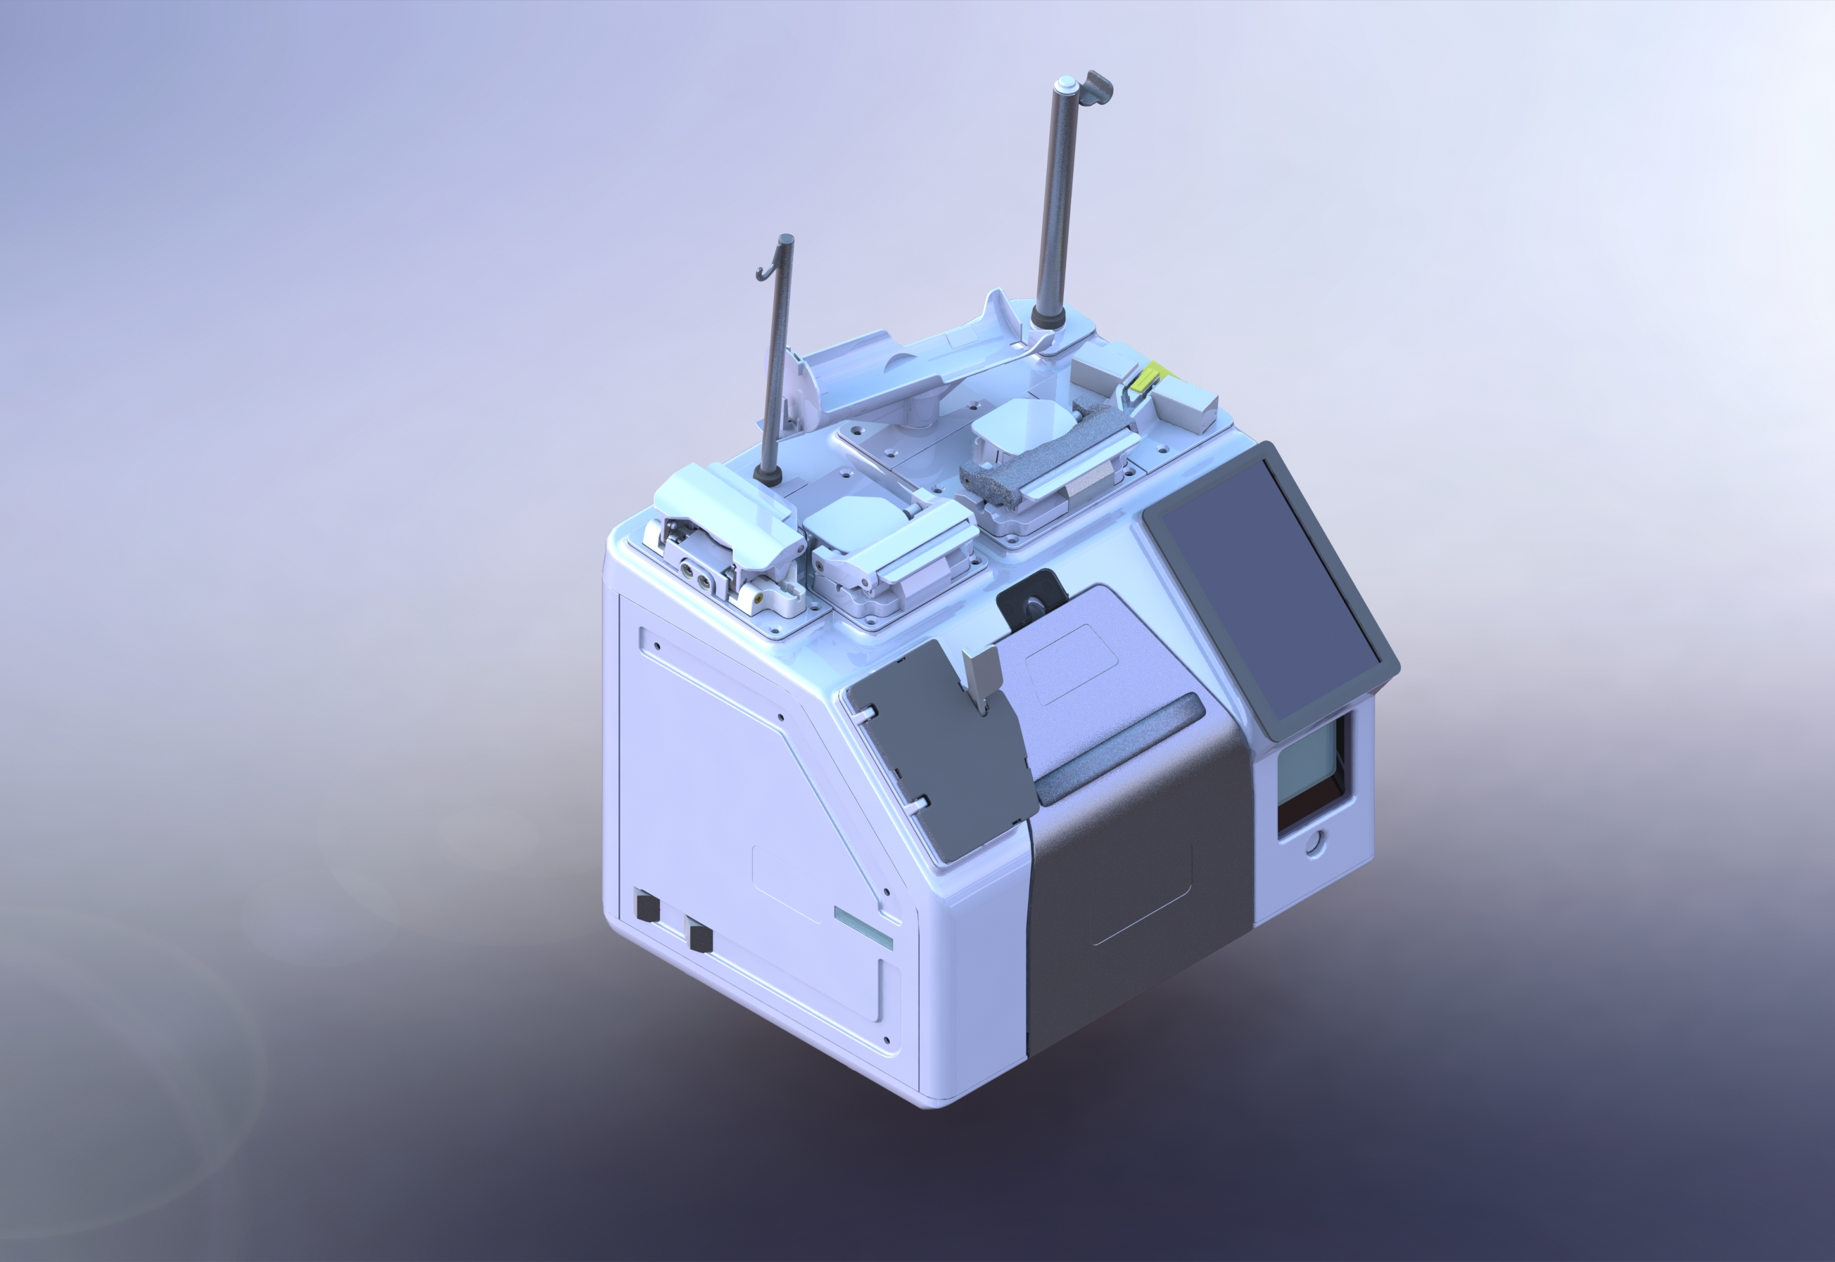
Rika Technical Overview
Notes:
Main Title Slide

Slide 7
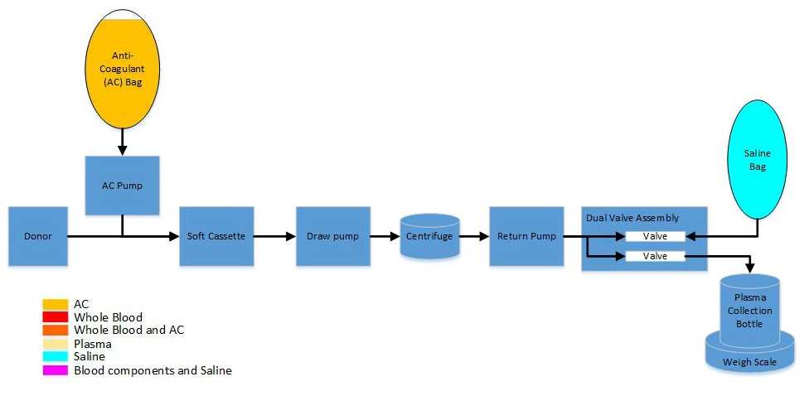
What is Rika
It is designed to draw whole blood from a donor, separate the plasma from the whole blood, move the plasma into a collection bottle and return remaining blood cells to the donor.
Rika is an automated apheresis system for plasma collection.
Notes:
Customer C only slide. Because all QTS’s are already operators. This slide coupled with the next slide is meant to help change their focus and set the tone of this training. This is not operator training.
You already know these definitions of what Rika is, an automated apheresis system used to draw whole blood and separate the plasma. For this training we are going to think of Rika in a different way.

Slide 8
What is Rika
It uses a computer to control subsystems, monitor sensors and detectors, regulate compressed air to ensure product is delivered.
Rika is an interconnected system of components that are controlled by a computer.
Notes:
Customer C only slide. Because all QTS’s are already operators. This slide, coupled with the previous slide is meant to help change their focus and set the tone of this training.
This is technical training.
Rika is an interconnected system of electrical wires and signals that are controlled by a single board computer.
It uses a computer to control subsystems, monitor sensors and detectors, regulate compressed air to ensure product is delivered.

Slide 9
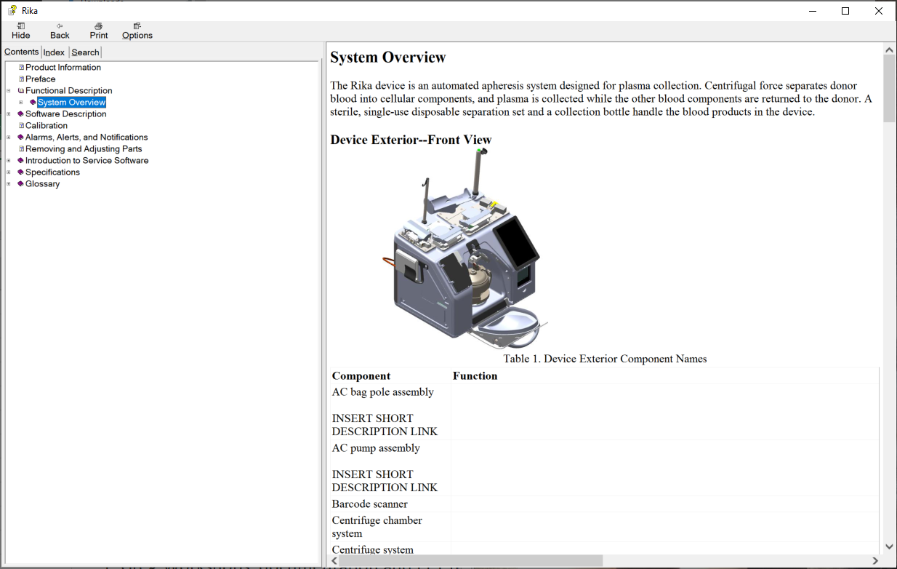
Service Manual Navigation
Notes:
Refer to document “how to use the CHM format”
Facilitator should provide a demo on how to use the service manual.
How to look up service messages, diagrams, and systems.

Slide 10
Workshop Instructions
The purpose of these workshops is to understand the device. It is not a race. Actively discuss questions with your team. Show the facilitator your work.
The facilitator will use your workshop discussions and participation to judge your knowledge of the device, in addition to the tests. They will look for the following:
Active technical conversations between your team, other students, and the facilitator.
Active participation in the hands-on elements.
Searching the service manual and other references.
Notes:
The purpose of these workshops is to understand the device. It is not a race. Actively discuss questions with your team. Show the facilitator your work.
The facilitator will use your workshop discussions and participation to judge your knowledge of the device, in addition to the tests. They will look for the following:
Active technical conversations between your team, other students, and the facilitator.
Active participation in the hands-on elements.
Searching the service manual and other references.

Slide 11
Workshop Instructions
Use the following references during the workshop:
Service Manual
Operator’s Manual
Quick Reference Guides (QRGs)
STS User Guide (STS Guide)
Preventive Maintenance procedure
Remove and Replace instructions (R and Rs)
Visual Spare Parts (VSP) Connect
Other Training Material
  Service messages, SharePoint, Box.com, Service manual addendum
Other students
Facilitator
Notes:
Use the following references during the workshop:
Service Manual
Operator’s Manual
Quick Reference Guides (QRGs)
STS User Guide (STS Guide)
Preventive Maintenance procedure
Remove and Replace instructions (R and Rs)
Visual Spare Parts (VSP) Connect
Other Training Material
Service messages, SharePoint, Box.com, Service manual addendum
Other students
Facilitator

Slide 12
Workshop Instructions
Follow the order- Don’t jump ahead.
Verbally answer the workshop questions and discuss with your team and other groups. The questions are intended to encourage discussion and discovery of how the device functions.
Write down any answers or notes that you think will help you understand the function of the device.
Perform all physical actions individually. There is no substitution for doing it yourself. If you are already competent with the action, skip it for yourself, but keep your partner in mind and give them advice.
Please attempt to write down as many answers as you can but remember the purpose of these workshops is to encourage hands-on learning.
These workshops will increase your confidence in the field by using the references to navigate the technical information to competently troubleshoot a device.
Notes:
Follow the order.
Verbally answer the workshop questions and discuss with your team and other groups. The questions are intended to encourage discussion and discovery of how the device functions.
Write down any answers or notes that you think will help you understand the function of the device.
Perform all physical actions individually. There is no substitution for doing it yourself. If you are already competent with the action, skip it for yourself, but keep your partner in mind and give them advice.
Please attempt to write down as many answers as you can but remember the purpose of these workshops is to encourage hands-on learning.
These workshops will increase your confidence in the field by using the references to navigate the technical information to competently troubleshoot a device.

Slide 13
Service Software Discussion
What is service software
Only accessible with the code 741789.
Only qualified service techs should access.
Allows manual control of individual components for troubleshooting purposes via the Hardware tab.
Allows access to auto-test and calibration procedures.
Auto-test and calibration procedures are needed to be completed prior to putting the device back into service. Touching the button shows you what is needed.
Allows access to logs.
Allows user to view serial number, set time and date, and configure network settings.
Back-up service software – allows user access via STS by holding Stop button for 3 seconds
Notes:
What is service software
Only accessible with the code 741789.
Only qualified service techs should access.
Allows manual control of individual components for troubleshooting purposes via the Hardware tab.
Allows access to auto-test and calibration procedures.
Auto-test and calibration procedures are needed to be completed prior to putting the device back into service. Touching the button shows you what is needed.
Allows access to logs
Allows user to view serial number, set time and date, and configure network settings.

Slide 14
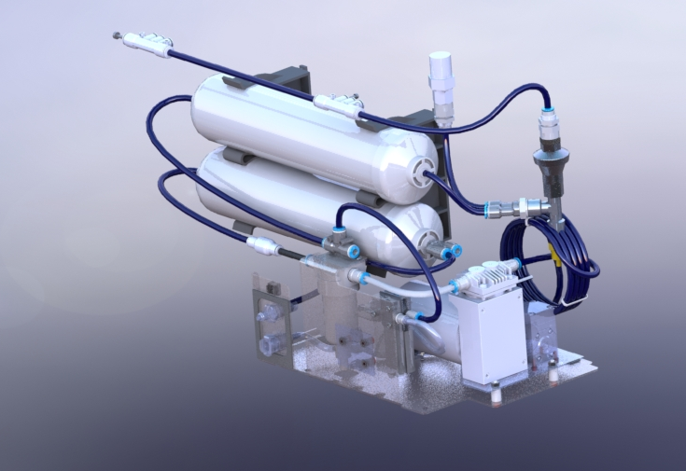
Service Software Demo
Notes:
High-Pressure and Cuff Air System Workshop #1 Title Slide
This slide is to delineate High-Pressure and Cuff Air workshop #1 section. Leave this slide up during the workshop as a visual reference of what the class is doing.
No talking points are needed.

Slide 15
High-Pressure and Cuff Air Systems
Notes:
High-Pressure and Cuff Air Systems Title Slide

Slide 16
High-Pressure and Cuff Air system objectives
Upon completion of this course, without assistance and using the class reference material, you will be able to:
Physically identify the major components of the high-pressure air system and cuff air system.
Describe the function of the high-pressure air system and cuff air system
Physically identify the major components the high-pressure air system supplies air to and the purpose of the air with little assistance
Control the high-pressure air system and cuff air system using service software
Locate and repair air leaks in the high-pressure air system and cuff air system
Notes:
Upon completion of this course, without assistance and using the class reference material, you will be able to:
Physically identify the major components of the high-pressure air system using supplied resources with little assistance
Describe the function of the high-pressure air system using supplied resources with little assistance
Physically identify the major components the high-pressure air system supplies air to and the purpose of the air with little assistance
Control the high-pressure air system using service software with little assistance
Locate and repair air leaks in the high-pressure air system with little assistance

Slide 17
High-Pressure Air System
Notes:
Discuss High-Pressure Air system.
Key Points:
The control computer controls the High-Pressure air system through the interface CCA to the multifunction CCA
The multifunction CCA directly commands the High-Pressure compressor and high-pressure control valve.
The High-Pressure sensor data is sent to the multifunction CCA via the interface CCA,
The high-pressure compressor pressurized the system to xx PSI PSI to the high-pressure regulator.
The high-pressure regulator regulates the air to xx PSI to the AC side manifold and saline side manifolds
Both the AC side manifold and Saline side manifold are pass through manifolds. They do not control the flow of regulated high-pressure air
Each individual assembly controls the flow of regulated high-pressure air via manifolds on their respective assemblies.
The soft cassette, and dual-valve manifolds are located next to the respective CCAs.
The chamber door lock manifold is located next to the chamber door lock.
The return pump assembly and the draw pump assembly have the manifolds mounted to the respective CCAs
Remember there is no high-pressure air going to the AC pump assembly.
The high-pressure relief valve is a manual spring-loaded valve that will vent the high-pressure air if it gets higher than xx PSI Max
The soft cassette housing assembly uses high-pressure air to actuate the top return, bottom return, and draw valves.
The draw pump assembly uses high-pressure air to open the track
The return pump assembly uses high-pressure air to close the track
The dual-valve assembly uses high-pressure air to open and close the collection and saline valves.
The centrifuge chamber door lock uses high-pressure air to open and close the centrifuge chamber door lock.

Slide 18
Cuff Air System
Notes:
Discuss Cuff Air system.
Key Points:
The cuff air system supplies low-pressure air to the cuff assembly and automatically maintains optimal pressure throughout the donation procedure.
The cuff air pressure system operates between 1-100 mmHg (0.019-1.934 psi).
The cuff relief valve is a mechanical spring-loaded valve that prevents the system from becoming over-pressurized. When the pressure reaches 3 PSI (155 mmHg) +/- 5% the valve opens to relieve pressure in the system.

Slide 19
High-Pressure and Cuff Air Systems Workshop Discussion
What we are going to do:
Trace the air tube system.
Remove the air assembly/module.
Remove the air tanks.
Identify air system components.
Use your resources to answer questions.
Use service software to control the system.
Upon completion of this module, you will be able to:
Notes:
What we are going to do:
Trace the air tube system
Remove the air sled
Remove the air tanks
Identify air system components
Use your resources to answer questions
Use service software to control the system

Slide 20
High-Pressure and Cuff Air System Workshop #1
Notes:
Provide an in-depth demonstration of the service software.
Include Hardware tab, Auto-test tab, Calibration tab, Configuration tab, and Log tab.
Talk about 24 volt switched voltage and compressor enable button.

Slide 21
High-Pressure Air System Review
What modules are controlled with the saline side manifold?
  Return pump, Dual-Valve, Door lock
What modules are controlled or monitored with the AC side manifold?
  Draw Pump, Soft Cassette, and High-Pressure Control Valve
What is the regulated high-pressure air pressure?
  75 PSI
What is the unregulated high-pressure air pressure?
  70-98 PSI
How many air compressors are in the Rika device?
  2 one for the high-pressure and one for the cuff.
Notes:
What modules are controlled with the saline side manifold?
Return pump, Dual-Valve, Door lock, high pressure control valve
What modules are controlled or monitored with the AC side manifold?
Draw Pump, Soft Cassette, and High-Pressure Control Valve
What does the regulated air pressure?
75 PSI
What is the unregulated air pressure?
70-98 PSI
How many air compressors are in the Rika device?
2 one for the high-pressure and one for the cuff.

Slide 22
Cuff Air System Review
What is the Cuff air systems operating pressure?
  Between 1-100 mmHg (0.019-1.934 psi)
At what pressure does the cuff relief valve open?
  3 PSI (155 mmHg) +/- 5%
Notes:
What is the Cuff air systems operating pressure?
Between 1-100 mmHg (0.019-1.934 psi)
At what pressure does the cuff relief valve open?
3 PSI (155 mmHg) +/- 5%

Slide 23
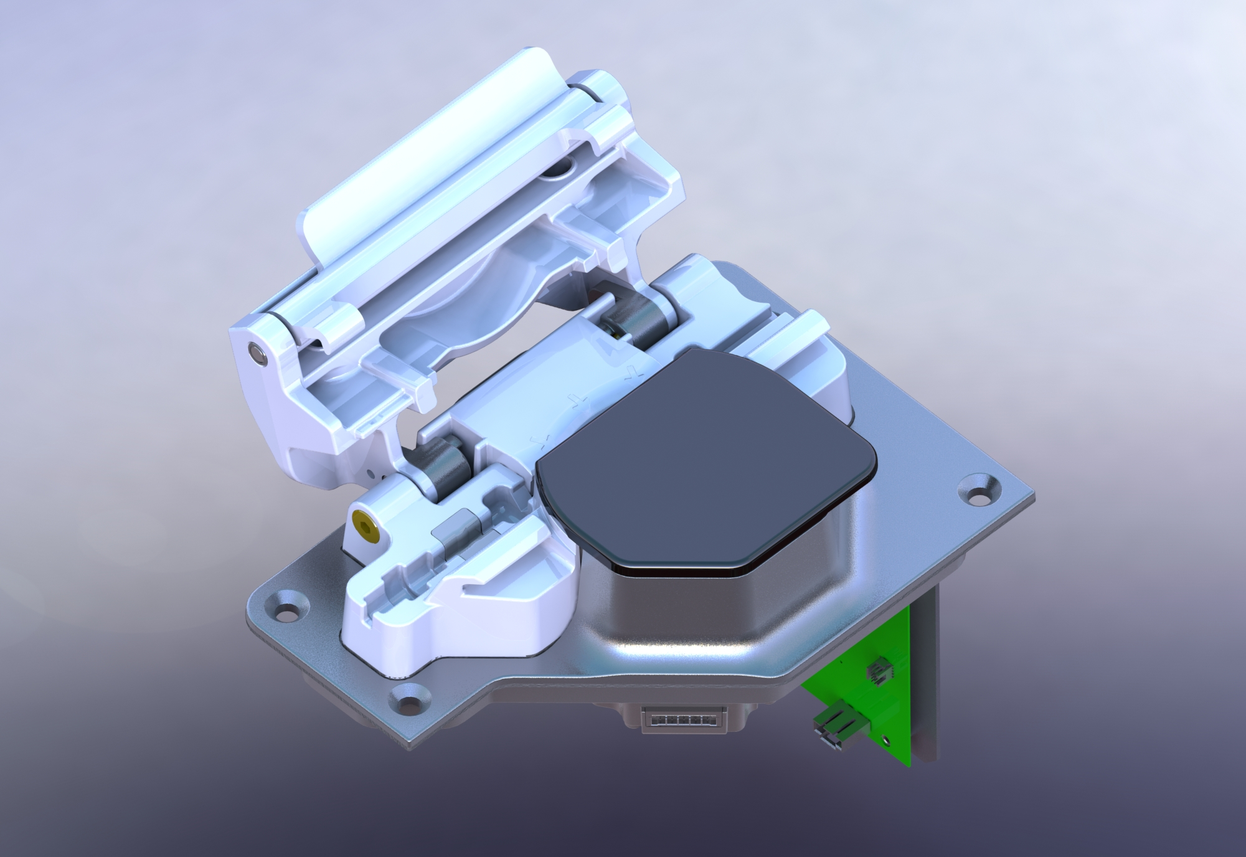
AC Pump Assembly
Notes:
AC Pump Assembly Title Slide

Slide 24
AC Pump Assembly module objectives
Upon completion of this course, without assistance and using the class reference material, you will be able to:
Physically identify the major components of the AC pump assembly
Describe the over all function of the AC pump assembly
Physically identify the secondary functions the AC pump assembly
Control the AC pump assembly with service software
Notes:
Upon completion of this module, you will be able to:
Physically identify the major components of the AC pump assembly with the use of the supplied resources with little assistance
Describe the over all function of the AC pump assembly using supplied resources with little assistance
Physically identify the secondary functions the AC pump assembly using supplied resources with little assistance
Control the AC pump assembly with service software using supplied resources with little assistance

Slide 25
AC Pump Assembly
Notes:
Discuss AC pump Assembly
Key Points:
The AC pump assembly has no high-pressure air.
The AC pump assembly contains secondary signals. The Centrifuged Chamber Door lock position sensor #2, the centrifuge chamber door position sensor #2, and Centrifuge Motor Hall effect sensor C are all monitored on the AC pump assembly CCA
The AC pump track is mechanically coupled to the AC pump lid
The AC line fluid detector detectors the presence of AC.
The AC pump assembly CCA controls the AC pump motor speed.
The Stop NC 2 signal is processed directly by the control computer, but it still gets it power from the AC pump assembly.
The AC pump rotor is red to match the AC Spike on the septation set and to distinguish it from the draw and return pump rotors.

Slide 26
Stop Button Power
Notes:
Discuss AC pump Assembly
Key Points:
The AC pump assembly has no high-pressure air.
The AC pump assembly contains secondary signals. The Centrifuged Chamber Door lock position sensor #2, the centrifuge chamber door position sensor #2, and Centrifuge Motor Hall effect sensor C are all monitored on the AC pump assembly CCA
The AC pump track is mechanically coupled to the AC pump lid
The AC line fluid detector detectors the presence of AC.
The AC pump assembly CCA controls the AC pump motor speed.
The Stop NC 2 signal is processed directly by the control computer, but it still gets it power from the AC pump assembly.
The AC pump rotor is red to match the AC Spike on the septation set and to distinguish it from the draw and return pump rotors.

Slide 27
AC Pump Assembly Workshop Discussion
What we are going to do:
Remove AC pump module.
Identify AC pump system components
Replace AC pump module
Use your resources to answer questions
Use service software to control the system
Upon completion of this module, you will be able to:
Notes:
What we are going to do:
Remove AC pump module.
Identify AC pump system components
Replace AC pump module
Use your resources to answer questions
Use service software to control the system

Slide 28
AC Pump Assembly Workshop #2
Notes:
AC Pump Assembly Workshop #2 Title Slide

Slide 29
AC Pump Assembly Review
What secondary signals are monitored by the AC pump CCA?
  Centrifuge Door lock #2, Centrifuge Door Closed #2, Motor Hall Effect C
What does the AC line fluid sensor detector sense?
  Senses the presence of AC in the AC line.
What does the AC pump Lid position sensor detect?
  The presence of the lid or the closed status of the AC lid.
What does the Stop NC 2 signal get from the AC pump CCA?
  Power
What color is the AC pump rotor?
  Red
Notes:
What secondary signals are monitored by the AC pump CCA?
Centrifuge Door lock #2, Centrifuge Door Closed #2, Motor Hall Effect C
What does the AC line fluid sensor detector do?
Senses the presence of AC in the AC line.
What does the AC pump Lid position sensor detect?
The presence of the lid or the closed status of the AC lid.
What does the Stop NC 2 signal get from the AC pump CCA?
Power
What color is the AC pump rotor?
Red

Slide 30
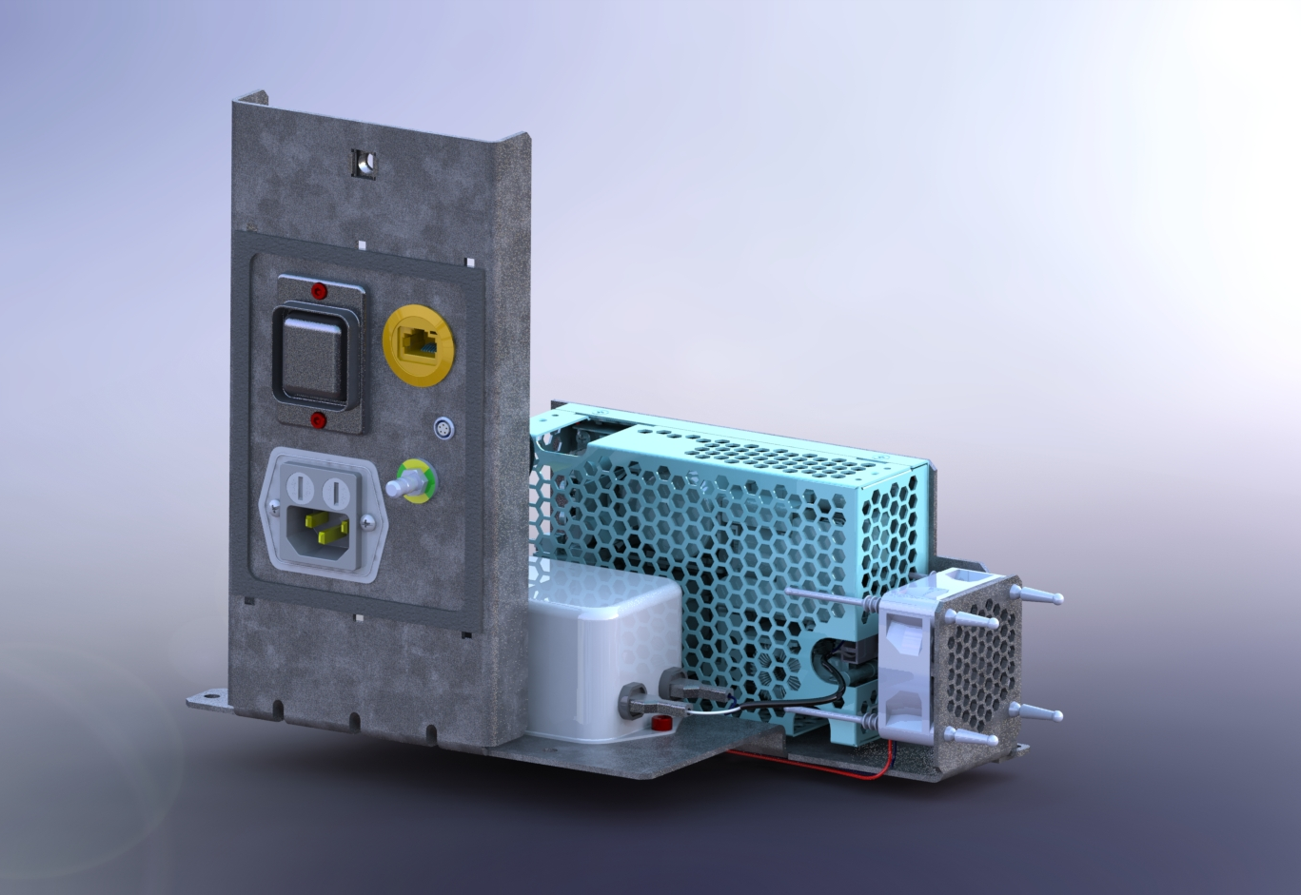
Power System Assembly
Notes:
Power System Assembly Title Slide

Slide 31
Power System Assembly Module Objectives
Upon completion of this course, without assistance and using the class reference material, you will be able to:
Physically identify the major components of the power system
Describe the over all function of the power system
Control the power system using service software
Notes:
Upon completion of this module, you will be able to:
Physically identify the major components of the power system with the use of the supplied resources
Describe the over all function of the power system
Preform maintenance on the power system using supplied resources
Troubleshoot the power system to its major components using supplied resources
Control the power system using service software

Slide 32
Power System Assembly
Notes:
Discuss the power system
Key Points:
The power system provides +24 V DC to the AC pump CCA, Dual Valve CCA. Soft Cassette housing CCA, Multifunction CCA, Draw Pump CCA, Return Pump CCA, and the Control computer.
All other DC power such as +3.3, +5, and -5 V DC is created on the respective assemblies.
The power system accepts 90 to 265 V AC input.
The power supply system supplies a +12 V DC signal to the power supply fan. This is the only +12 V DC signal the power supply system supplies.
The power inlet assembly contains the power cord receptacle, a line filter, and fuses One in the input and one on the return.
The power inlet assembly provides IP65 Protection between the inlet and connector pins.

Slide 33
Power System Assembly Workshop Discussion
What we are going to do:
Remove the power sled
Identify power system components
Use your resources to answer questions
Use service software to control the system
Upon completion of this module, you will be able to:
Notes:
What we are going to do:
Remove the power sled
Identify power system components
Use your resources to answer questions
Use service software to control the system

Slide 34
Power System Assembly Workshop #3
Notes:
Power System Assembly Workshop #3 Title Slide

Slide 35
Power System Assembly Review
How much voltage does the Rika power system supply?
  24 V DC for the Rika device and +12 V DC for the power supply fan
Where does the +24 V DC power go?
  AC pump CCA, Dual Valve CCA. Soft Cassette housing CCA, Multifunction CCA, Draw Pump CCA, Return Pump CCA, and the Control computer.
What voltage range does the power system accept?
  100 to 240 V AC input 50 – 60Hz
What does the power inlet contain?
  The power inlet assembly contains the power cord receptacle, a line filter, and fuses
Notes:
What type of power does the Rika power supply
24 V DC for the Rika device and +12 V DC for the power supply fan
Where does the +24 V DC power go?
AC pump CCA, Dual Valve CCA. Soft Cassette housing CCA, Multifunction CCA, Draw Pump CCA, Return Pump CCA, and the Control computer.
What type of power does the power system accept?
100 to 240 V AC input
What does the power inlet contain?
The power inlet assembly contains the power cord receptacle, a line filter, and fuses

Slide 36
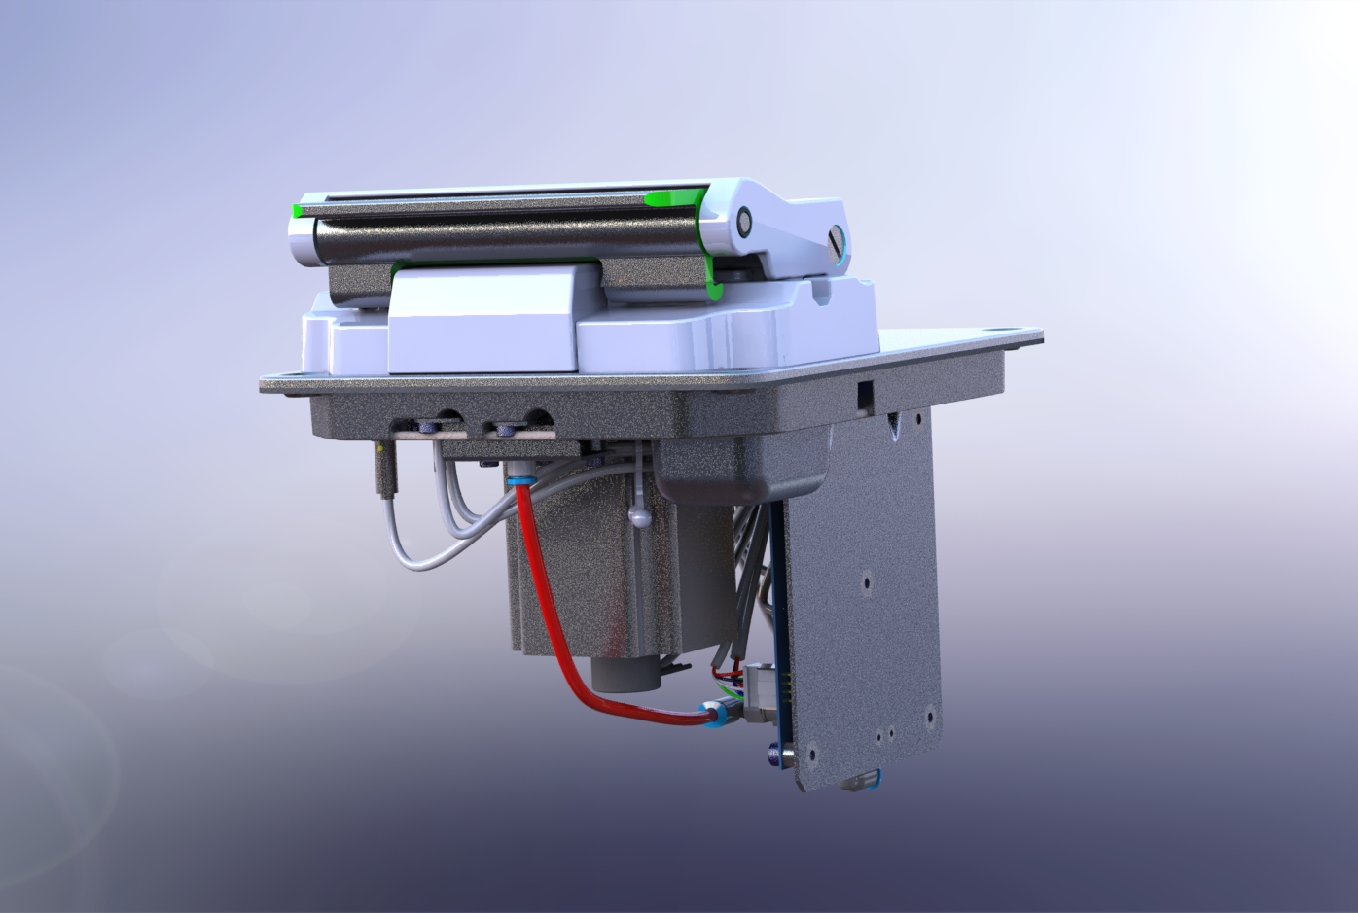
Draw Pump and Return Pump Assemblies
Notes:
Draw Pump and Return Pump Assemblies Title Slide

Slide 37
Draw Pump and Return Pump Assembly Objectives
Upon completion of this course, without assistance and using the class reference material, you will be able to:
Physically identify the major components of the draw and return pump assemblies
Describe the over all function of the draw and return pump assemblies
Physically identify the differences between the draw and return pump assemblies
Control the draw and return pump assemblies using service software
Notes:
Upon completion of this module, you will be able to:
Physically identify the major components of the draw and return pump assemblies with the use of the supplied resources with minimal direction
Describe the over all function of the draw and return pump assemblies using supplied resources with minimal direction
Physically identify the differences between the draw and return pump assemblies using supplied resources with minimal direction
Control the draw and return pump assemblies using service software using supplied resources with minimal direction

Slide 38
Draw Pump Assembly
Notes:
Discuss draw pump assembly
Key Points:
The draw pump assembly draws whole blood from the donor and sends it to the centrifuge to be separated into plasma and other components.
The draw pump track is normally closed.
When the track is in its resting, closed state, it is held against the rollers with springs.
When the track is in its active, open state, high pressure air pushes the block away from the rollers to allow fluid to flow through the disposable tube.
The draw pump track contains a pressure sensor.
The draw pump cap is green to match the door handle and distinguish it from the AC and return pump rotors.
The draw pump assembly gets high pressure air from the AC side manifold

Slide 39
Return Pump Assembly
Notes:
Discuss return pump assembly
Key Points:
The return pump returns blood components to the donor during the return cycle until air is detected at the line sensor, signaling the device to switch back to the draw cycle.
The return pump assembly also moves saline back to the donor through the return pump tubing line. It senses line pressure, the presence of different types of cells, and the return pump lid position.
The return pump track is normally open.
The return pump track is a metal block that pushes the return line tube against the return pump rollers to create a peristaltic force.
When the block is in its resting, open state, it is held away from the rollers with springs.
When the block is in its active, closed state, high pressure air pushes the block against the rollers to compress the disposable tube.
The return pump track contains a pressure sensor.
The return pump rotor is yellow to match the to match the dual valve cover and distinguish it from the draw and AC pump rotors.
The return pump assembly gets high pressure air from the saline side manifold

Slide 40
Draw Pump and Return Pump Assembly workshop Discussion
What we are going to do:
Remove return pump assembly
Remove Draw pump assembly
Disconnect air connection port
Identify return pump assembly components
Remove and replace rotor, actuator, and motor
Reconnect air connection port
Replace return pump assembly
Replace draw bump assembly
Use your resources to answer questions
Use service software to control the system
Upon completion of this module, you will be able to:
Notes:
What we are going to do:
Remove return pump assembly
Remove Draw pump assembly
Disconnect air connection port
Identify return pump assembly components
Remove and replace rotor, actuator, and motor
Reconnect air connection port
Replace return pump assembly
Replace draw bump assembly
Use your resources to answer questions
Use service software to control the system

Slide 41
Draw Pump and Return Pump Assemblies Workshop #4
Notes:
Draw Pump and Return Pump Assemblies Workshop #4 Title Slide

Slide 42
Draw Pump Assembly Review
The draw pump track is normally in what position?
  Normally closed.
The draw pump track gets its air from?
  AC side manifold
What color is the draw pump rotor?
  Green
What does the draw pump centrifuge pressure sensor do?
  It monitors the pressure of the disposable tubing between the draw pump and the centrifuge while fluid is flowing into the centrifuge.
Notes:
The draw pump track is normally in what position?
Normally closed.
The draw pump track gets its air from?
AC side manifold
What color is the draw pump rotor?
Green
What does the draw pump centrifuge pressure sensor do?
It monitors the pressure of the disposable tubing between the draw pump and the centrifuge while fluid is flowing into the centrifuge.

Slide 43
Return Pump Assembly Review
The return pump track is normally in what position?
  Normally open.
The return pump track gets its air from?
  Saline side manifold
What color is the return pump rotor?
  Yellow
What does the return pump centrifuge pressure sensor do?
  It monitors the pressure of the disposable tubing between the return pump and the centrifuge while fluid is flowing into the centrifuge.
What does the line sensor do?
  It detects hemolysis, when an empty tube becomes filled with plasma, when plasma transitions to buffy coat, or when excess air is present.
Notes:
The return pump track is normally in what position?
Normally open.
The return pump track gets its air from?
Saline side manifold
What color is the return pump rotor?
Yellow
What does the return pump centrifuge pressure sensor do?
It monitors the pressure of the disposable tubing between the return pump and the centrifuge while fluid is flowing into the centrifuge.
What does the line sensor do?
It detects hemolysis, when an empty tube becomes filled with plasma, when plasma transitions to buffy coat, or when excess air is present.

Slide 44
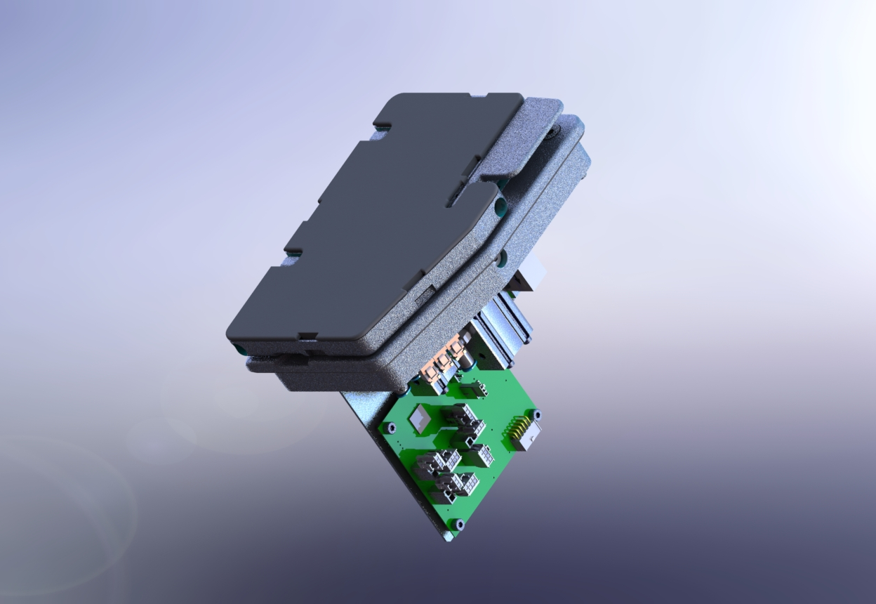
Soft Cassette Housing Assembly
Notes:
Soft Cassette Housing Assembly Title Slide

Slide 45
Soft Cassette Housing Assembly Objectives
Upon completion of this course, without assistance and using the class reference material, you will be able to:
Physically identify the major components of soft cassette housing assembly
Describe the over all function of the soft cassette housing assembly
Control the soft cassette housing assembly using service software
Notes:
Upon completion of this module, you will be able to:
Physically identify the major components of soft cassette housing assembly with the use of the supplied resources using supplied resources with minimal direction
Describe the over all function of the soft cassette housing assembly using supplied resources with minimal direction
Control the soft cassette housing assembly using service software using supplied resources with minimal direction

Slide 46
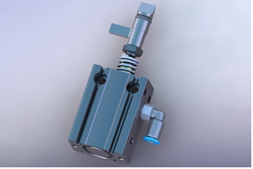
Soft Cassette Housing Assembly
Notes:
Discuss draw soft cassette housing assembly
Key Points:
The soft cassette housing assembly contains sensors and valves that monitor and control the flow of fluid through the process disposable tubing lines that go to and from the donor.
The access pressure sensor is a load cell that detects pressure changes in the draw and return cycles.
The top return valve actuator has an internal spring that extends the rod into the closed position. High pressure air opens the actuator, which retracts the rod into the open position. The actuator safe state is closed. The top actuator is above the soft cassette return chamber.
The actual valve is part of the separation set.
The bottom return valve actuator has an internal spring that extends the rod into the closed position. High pressure air opens the actuator, which retracts the rod into the open position. The actuator safe state is closed. The bottom return valve actuator is below the soft cassette return chamber. The actual valve is part of the separation set.
The draw valve actuator has an internal spring that extends the rod into the closed position. High pressure air opens the actuator, which retracts the rod into the open position. The actuator safe state is closed. The draw valve actuator is to the right of the soft cassette return chamber. The actual valve is part of the separation set.
During normal operation, the valves actuators are held closed by a spring and opened with high pressure air.

Slide 47
Soft Cassette Housing Assembly workshop Discussion
What we are going to do:
Remove soft cassette housing module
Remove and replace actuators
Remove and replace APS
Replace soft cassette housing module
Use your resources to answer questions
Use service software to control the system
Upon completion of this module, you will be able to:
Notes:
What we are going to do:
Remove soft cassette housing module
Remove and replace actuators
Remove and replace APS
Remove and replace Latch spring
Replace soft cassette housing module
Use your resources to answer questions
Use service software to control the system

Slide 48
Soft Cassette Housing Assembly Workshop #5
Notes:
Soft Cassette Housing Assembly Workshop #5 Title Slide

Slide 49
Soft Cassette Housing Assembly Review
What is the state of the valves during normal operation during the draw cycle?
  The draw valve will be opened, and the top and bottom return valve will be closed.
What is the state of the valves during normal operation during the rinse-back cycle?
  The draw valve will be closed, and the top and bottom return valve will be opened.
Where does the soft cassette housing air manifold subassembly get its air from?
  AC side manifold
What is the purpose of the donor line fluid detector?
  detects entrained air in fluid returning to the donor
Notes:
What is the state of the valves during normal operation during the draw cycle?
The draw valve will be opened, and the top and bottom return valve will be closed.
What is the state of the valves during normal operation during the rinse-back cycle?
The draw valve will be closed, and the top and bottom return valve will be opened.
Where does the soft cassette housing air manifold subassembly get its air from?
AC side manifold
What is the purpose of the donor line fluid detector?
detects entrained air in fluid returning to the donor

Slide 50
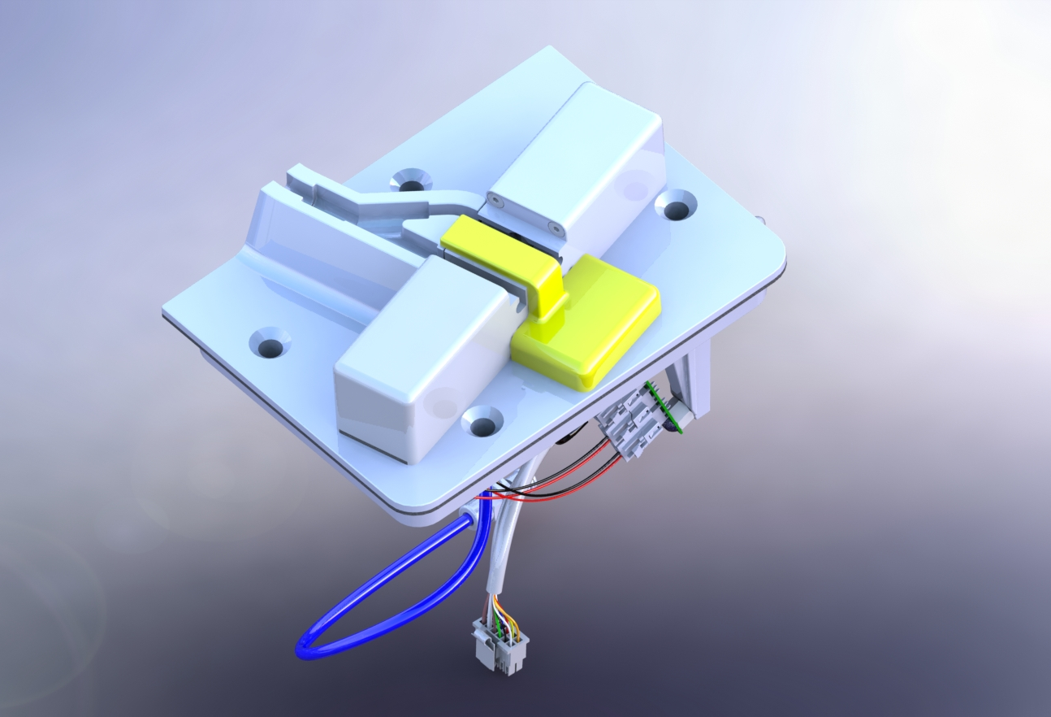
Dual-Valve Assembly
Notes:
Dual-Valve Assembly Title Slide

Slide 51
Dual-Valve Assembly Objectives
Upon completion of this course, without assistance and using the class reference material, you will be able to:
Physically identify the major components of the dual-valve assembly
Describe the over all function of the dual-valve assembly
Physically identify the secondary functions of the dual-valve assembly
Control the dual-valve assembly using service software
Notes:
Upon completion of this module, you will be able to:
Physically identify the major components of the dual-valve assembly using supplied resources with minimal direction
Describe the over all function of the dual-valve assembly using supplied resources with minimal direction
Physically identify the secondary functions of the dual-valve assembly using supplied resources with minimal direction
Control the dual-valve assembly using service software using supplied resources with minimal direction

Slide 52
Dual-Valve Assembly
Notes:
Discuss dual-valve assembly
Key Points:
During plasma collection, springs hold the collection valve open, and the saline valve closed. This allows plasma to flow into the collection bottle while it prevents saline flow.
During rinse-back the collection valve is closed, and the saline valve is open. This allows saline to flow from the saline bag while it prevents plasma from flowing out of the bottle.
The sealing reference point is the yellow reference area on the dual-valve assembly that identifies the sealing location on the collection line.

Slide 53
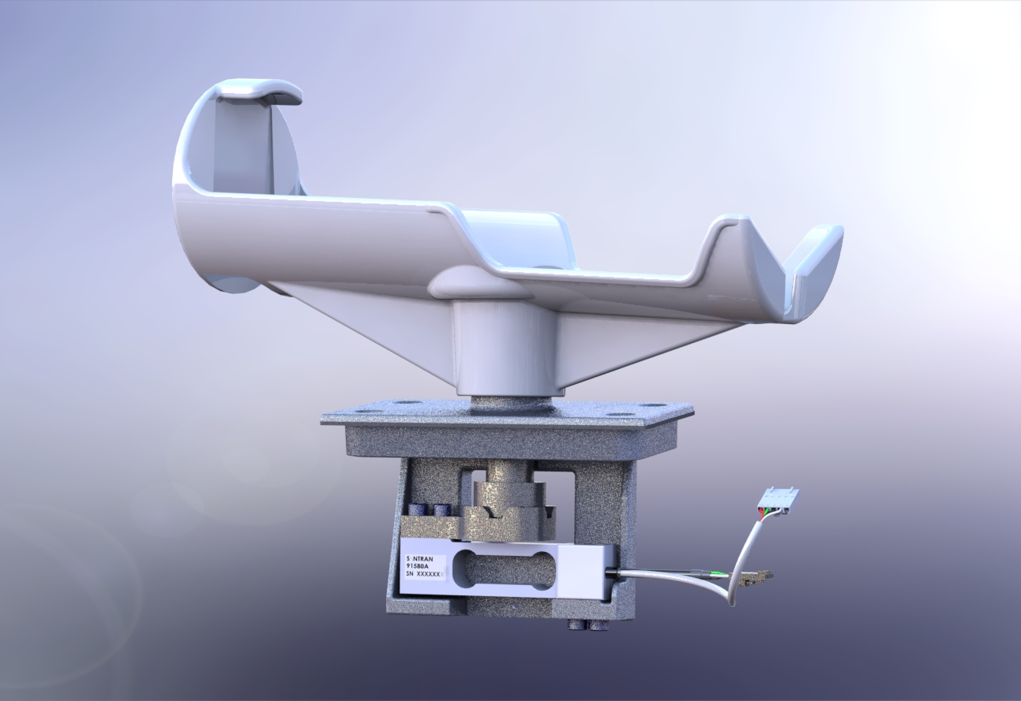
Weigh Station / Beacon and Saline Bag Pole Assemblies
Notes:
Weigh Station / Beacon and Saline Bag Pole Assemblies Title Slide

Slide 54
Weigh Station / Beacon and Saline Bag Pole Assemblies Objectives
Upon completion of this course, without assistance and using the class reference material, you will be able to:
Physically identify the major components of the weigh station and beacon assemblies
Describe the over all function of the weigh station and beacon assemblies
Control the weigh station and beacon assemblies using service software
Notes:
Upon completion of this module, you will be able to:
Physically identify the major components of the weigh station and beacon assemblies
Describe the over all function of the weigh station and beacon assemblies
Control the weigh station and beacon assemblies using service software

Slide 55
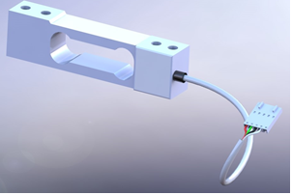
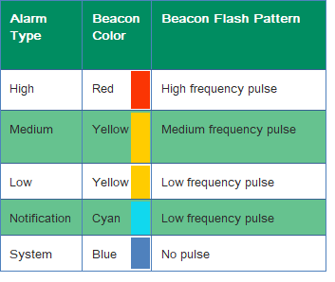
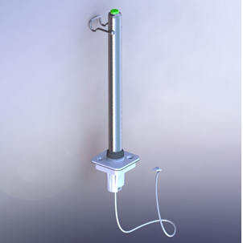
Weigh Station / Beacon Assemblies
Weigh Station Load Cell
Beacon Colors
Beacon and Saline Bag pole Assembly
Notes:
Discuss weigh station and beacon assembly
Weight Station Key Points:
The weigh station system measures the weight of a collection bottle. When the target weight is reached, the device ends the collection run.
There is a magnetic connection between the bottle holder shaft and the load cell. The coupler is designed to release the bottle holder when excessive force is applied.
The loadcell is a type of force transducer, called a single point shear beam, that converts the force of the collection bottle weight into an electrical signal.
Beacon Key Points:
The beacon is an LED at the top of the saline bag pole and is part of the beacon and saline bag pole assembly.
It provides a visual indicator of alarms, alerts, and the various states of the procedure and the device through color and flashing patterns.
The beacon wiring harness connects to the dual-valve assembly CCA.

Slide 56
Dual-Valve / Weigh Station / Beacon Assemblies Workshop Discussion
What we are going to do:
Remove dual-valve module
Remove and replace actuators
Remove and replace beacon assembly
Remove and replace weigh station
Replace dual-valve module
Use your resources to answer questions
Use service software to control the system
Upon completion of this module, you will be able to:
Notes:
What we are going to do:
Remove dual-valve module
Remove and replace actuators
Replace dual-valve module
Use your resources to answer questions
Use service software to control the system

Slide 57
Dual-Valve / Weigh Station / Beacon and Saline Bag Pole Assemblies Workshop #6
Notes:
Dual-valve assembly workshop #6 title slide

Slide 58
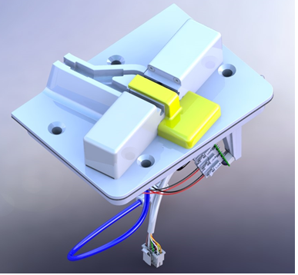
Dual-Valve Assembly Review
What is the yellow component on the dual-valve assembly?
  The sealing reference point – It identifies the sealing location on the collection line
Where does the dual-valve assembly get its air from?
  Saline side manifold
What two components, that are not part of the dual valve assembly, are processed by the dual-valve assembly CCA?
  Beacon and weigh station load cell.
What is the state of each valve during plasma collection?
  During plasma collection, springs hold the collection valve open, and the saline valve closed
What is the state of each valve during rinse-back?
  During rinse-back the collection valve is closed, and the saline valve is open.
Notes:
What is the yellow component on the dual-valve assembly?
The sealing reference point – It identifies the sealing location on the collection line
Where does the dual-valve assembly get its air from?
Saline side manifold
What two components, that are not part of the dual valve assembly, are processed by the dual-valve assembly CCA?
Beacon and weigh station load cell.
What is the state of each valve during plasma collection?
During plasma collection, springs hold the collection valve open, and the saline valve closed
What is the state of each valve during rinse-back?
During rinseback the collection valve is closed, and the saline valve is open.

Slide 59
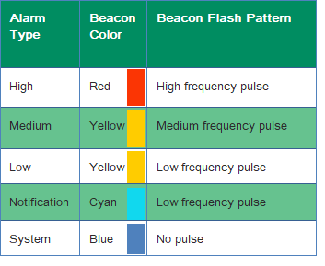
Weigh Station / Beacon Assemblies Review
What CCA directly controls the beacon?
  Dual-valve CCA.
What CCA directly monitors the weigh station?
  Dual-valve CCA
What is the weigh station load cell for?
  It converts the force of the collection bottle weight into an electrical signal
What are the beacon colors and what are the associated alarm priorities?
  Red, Yellow, Cyan, and Blue.

Slide 60
Centrifuge / Centrifuge Chamber Systems
Notes:
Centrifuge / Centrifuge Chamber Assemblies Title Slide

Slide 61
Centrifuge / Centrifuge Chamber System Module Objectives
Upon completion of this course, without assistance and using the class reference material, you will be able to:
Physically identify the major components of the centrifuge and centrifuge chamber assemblies
Describe the over all function of the centrifuge and centrifuge chamber assemblies
Identify the secondary signals monitored by the AC pump CCA from the centrifuge and centrifuge chamber assemblies
Control the centrifuge and centrifuge chamber assemblies
Notes:
Upon completion of this module, you will be able to:
Physically identify the major components of the centrifuge and centrifuge chamber assemblies using supplied resources with minimal direction
Describe the over all function of the centrifuge and centrifuge chamber assemblies using supplied resources with minimal direction
Physically identify the secondary monitors of the centrifuge and centrifuge chamber assemblies using supplied resources with minimal direction
Control the centrifuge and centrifuge chamber assemblies using service software with minimal direction

Slide 62
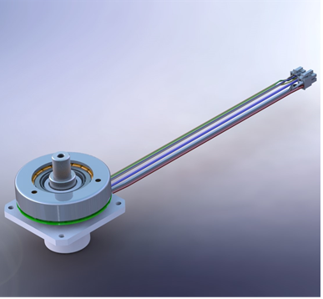
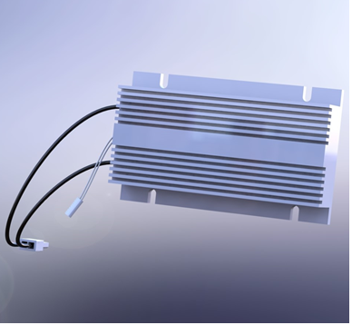
Centrifuge System
Notes:
Discuses centrifuge assembly
Key Points:
The centrifuge spins up to 5000 RPM to separate the blood.
The motor itself spins at 2500 RPM with a gear ratio of 2:1.
The multifunction CCA uses an embedded motor controller to operate the motor.
Feedback from the three Hall Effect sensors are sent back to the Multifunction CCA and are used to measure actual speed of the centrifuge.
Hall Effect Sensor C is also sent to the AC Pump CCA as a redundant check to make sure the centrifuge has stopped.
The vibration mitigation system incorporates several features to reduce and manage vibration generated by the spinning centrifuge.
The vibration sensor monitors the basin for excessive vibration.
Whenever the centrifuge needs to be stopped or its speed needs to be reduced, a braking resistor circuit automatically switches on to absorb the excess energy of the spinning centrifuge and slow it down.
The thermistor on the motor senses the temperature within the motor.
The Centrifuge Stop prevents the centrifuge from moving when the filler housing is open. The centrifuge stop must be down in order to open the filler housing latch.

Slide 63
Centrifuge Chamber System
Notes:
Discuses centrifuge chamber assembly
Key Points:
The centrifuge chamber assembly contains
The centrifuge door
The centrifuge basin
The centrifuge door lock assembly
The centrifuge top loop holder.
The leak detector is a resistance circuit with an adhesive backing that adheres to the wall and floor of the basin to detect leaks.
The top loop assembly holds the top loop of the separation set. In the loading position, the loop holder is pushed toward the rear of the basin so the centrifuge filler can be opened and closed. In the operating position, the loop holder is pulled out so the disposable is supported during the procedure.
The centrifuge door lock is an air actuated valve that pushes and pulls a lock shaft in to and out of the door lock receiver.
There is a door unlock lanyard This is a metal lanyard that allows the technician to unlock the centrifuge chamber door in case power is lost.

Slide 64
Centrifuge / Centrifuge Chamber Systems Workshop Discussion
What we are going to do:
Remove and replace centrifuge
Remove and replace centrifuge basin
Remove and replace leak detector
Remove and replace centrifuge motor
Remove and replace multifunction CCA
Use your resources to answer questions
Use service software to control the system
Upon completion of this module, you will be able to:
Notes:
What we are going to do:
Remove and replace centrifuge
Remove and replace centrifuge basin
Remove and replace leak detector
Remove and replace centrifuge motor
Remove and replace door lock
Remove and replace multifunction CCA
Use your resources to answer questions
Use service software to control the system

Slide 65
Centrifuge / Centrifuge Chamber Systems Workshop #7
Notes:
Centrifuge / Centrifuge Chamber Assemblies Workshop #8 Title Slide

Slide 66
Centrifuge Chamber System Review
What components does the centrifuge chamber assembly contain?
  The centrifuge door, the centrifuge basin, the centrifuge door lock assembly, the centrifuge top loop holder.
What is the purpose of the centrifuge door unlock lanyard?
  allows the technician to unlock the centrifuge chamber door in case power is lost
What signals are monitored by the AC pump Assembly CCA?
  Motor Hall C, Centrifuge door locked 2, and centrifuge door closed 2.
What position does the Centrifuge door lock default to?
  The last position it was in.
Where does he centrifuge chamber door lock manifold get high-pressure air from?
  Saline side manifold
Notes:
What components does the centrifuge chamber assembly contain?
The centrifuge door, the centrifuge basin, the centrifuge door lock assembly, the centrifuge top loop holder.
What is the purpose of the centrifuge door unlock lanyard?
allows the technician to unlock the centrifuge chamber door in case power is lost
What signals are monitored by the AC pump Assembly CCA?
Motor Hall C, Centrifuge door locked 2, and centrifuge door closed 2.
What position does the Centrifuge door lock default to?
The last position it was in.
Where does he centrifuge chamber door lock manifold get high-pressure air from?
Saline side manifold

Slide 67
Centrifuge System Review
The centrifuge assembly contains?
  Filler housing, Braking resister, Centrifuge motor assembly, Centrifuge base, Vibration mitigation system
What is the purpose of the braking resistor?
  slows the centrifuge rotation by resisting the back EMF (electro-motive force) in the centrifuge motor
What is the purpose of the centrifuge motor?
  It spins the filler to the commanded speed.
What is the centrifuge stop for?
  Prevents the centrifuge from moving when the filler housing is open.
What CCAs monitor the hall effect sensors?
  Hall effect sensor A, B, and C are monitored by the Multifunction CCA. Hall effect sensor C is also sent to the AC pump assembly CCA.
Notes:
The centrifuge assembly contains?
Filler housing, Braking resister, Centrifuge motor assembly, Centrifuge base, Vibration mitigation system
What is the purpose of the braking resistor?
slows the centrifuge rotation by resisting the back EMF (electro-motive force) in the centrifuge motor
What is the purpose of the centrifuge motor?
It spins the filler to the commanded speed.
What does the centrifuge stop do?
Prevents the centrifuge from moving when the filler housing is open.
What CCAs monitor the hall effect sensors?
Hall effect sensor A, B, and C are monitored by the Multifunction CCA. Hall effect sensor C is also sent to the AC pump assembly CCA.

Slide 68
Control System / STS
Notes:
Control System Title Slide

Slide 69
Control System Module Objectives
Upon completion of this course, without assistance and using the class reference material, you will be able to:
Physically identify the major components of the control system with
Describe the over all function of the control system
Control the control system using service software
Use STS to update the software, download dlogs and update serial number
Notes:
Upon completion of this module, you will be able to:
Physically identify the major components of the control system with
Describe the over all function of the control system
Control the control system using service software
Use STS to update the software, download dlogs and update serial number

Slide 70
Control System
Notes:
Discuses control system assembly
Key Points:
The control system consists of the control computer, the Ethernet components and it houses the battery backup.
The control computer is the brains of the device.
The control computer controls the 24 V DC switched enable signal that controls the 24 VSW DC power to all nodes.
The control computer generates the video sent to the touchscreen and the audio sent to the speaker.
The control computer controls the Ethernet connection and consumes battery back up power.
The control computer receives data from the barcode scanner through the USB port.
The control computer monitors Stop NC 2
If you ever replace the control computer, specifically the SSD you will need to connect to STS to rewrite the seral number. This will be part of the Workshop

Slide 71
Control System – CAN bus
Notes:
Discuses CAN bus
Key Points:
CAN =Controller Area Network
In the device, CAN bus uses 7 nodes wired in series with the control computer acting as the control node. The nodes are wired as follows. They are listed in order of communication:
The Control computer
The Multifunction CCA
The Return Pump CCA
The Draw pump CCA
The AC pump CCA
The Dual-valve CCA
And the Soft cassette housing CCA
Although it is not a node, there is a CAN bus terminating resistor (R2) located on the interface board.
If you ever replace a CAN bus node and the node software does not match the other nodes you will have to do a software upgrade for the device. This is done using STS.

Slide 72
Control System / STS Workshop Discussion
What we are going to do:
Remove and replace the touchscreen
Remove and replace the SSD card
Using STS upgrade software on the Rika device
Use your resources to answer questions
Use service software to control the system
Notes:
What we are going to do:
Remove and replace the touchscreen
Remove and replace the SSD card
Using STS upgrade software on the Rika device
Use your resources to answer questions
Use service software to control the system

Slide 73
Control System / STS Workshop #8
Notes:
Control System Workshop #9 Title Slide

Slide 74
Control System Review
What does the battery back up do?
  Provides backup power to the control computer.
Where does the video for the touchscreen come from?
  The control computer
What are the 7 CAN bus nodes?
  The control computer, The Multifunction CCA, The Return Pump CCA, The Draw pump CCA, The AC pump CCA, The Dual-valve CCA, And the Soft cassette housing CCA
Where is the master CAN bus controller?
  The control computer
Where is the solid-state drive (SSD)?
  The control computer
When would you need to use STS?
  Download Dlogs, Upgrade software, change serial number due to new SSD
Where is the CAN bus terminating resister (RS) located?
  The interface CCA
Notes:
What does the battery back up do?
Provides backup power to the control computer.
Where does the video for the touchscreen come from?
The control computer
What are the 7 CAN bus nodes?
The control computer, The Multifunction CCA, The Return Pump CCA, The Draw pump CCA, The AC pump CCA, The Dual-valve CCA, And the Soft cassette housing CCA
Where is the master CAN bus controller?
The control computer
Where is the solid-state drive (SSD)?
The control computer
When would you need to use STS?
Download Dlogs, Upgrade software, change serial number due to new SSD
Where is the CAN bus terminating resister (RS) located?
The interface CCA

Slide 75
Troubleshooting Standard
Notes:
Troubleshooting Standard Title Slide

Slide 76
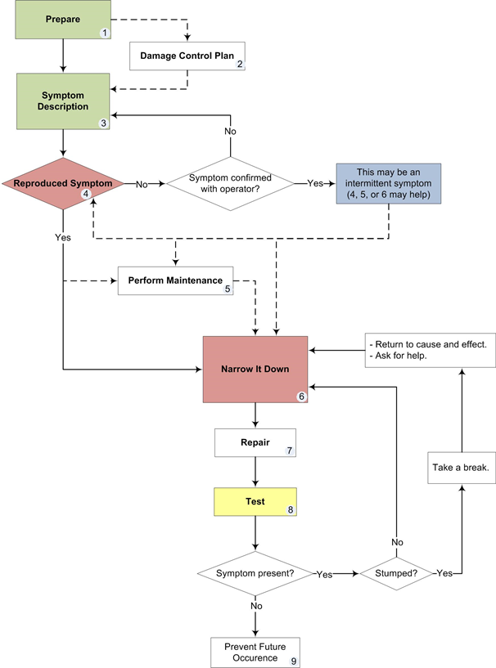
Troubleshooting Standard
Discussion and Service Manual
Notes:
Refer to document “troubleshooting Standard doc”, “QuickRefGuideTroubleStandard”, and “worksheettroublestandard”

Slide 77
Troubleshooting Workshop 9 Discussion
What we are going to do:
Using the troubleshooting standard, you will troubleshoot faults to the nearest major component.
Use your resources to answer questions
Notes:
What we are going to do:
Using the troubleshooting standard, you will troubleshoot faults to the nearest major component.
Use your resources to answer questions

Slide 78
Troubleshooting Fault Workshop #9
Notes:
Troubleshooting Fault Workshop #10 Title Slide

Slide 79
Troubleshooting Review
What is the first thing to do when troubleshooting?
  Prepare
What is a good way to prevent failures before they happen?
  Perform maintenance
What should you do if you cannot reproduce the problem?
  It might be intermittent. Confirm with operator. Try to find out what they were doing at the time of the error. Check data logs. Attempt to narrow it down.
How do you ensure the repair fixed the problem?
  Test
Notes:
What is the first thing to do when troubleshooting?
Prepare
What is a good way to prevent failures before they happen?
Perform maintenance
What should you do if you cannot reproduce the problem?
It might be intermittent. Confirm with operator. Try to find out what they were doing at the time of the error. Check data logs. Attempt to narrow it down.
How do you ensure the repair fixed the problem?
Test

Slide 80
IQ, OQ, PQ, and PM
Notes:
IQ, OQ, PQ Title Slide

Slide 81
IQ, OQ, PQ, and PM
Upon completion of this course, without assistance and using the class reference material, you will be able to:
Complete the entire installation qualification from start to finish.
Complete the entire operational qualification from start to finish.
Complete the entire performance qualification from start to finish.
Complete the entire preventive maintenance procedure from start to finish.
Notes:
Upon completion of this module, you will be able to:
Physically identify the major components of the centrifuge and centrifuge chamber assemblies using supplied resources with minimal direction
Describe the over all function of the centrifuge and centrifuge chamber assemblies using supplied resources with minimal direction
Physically identify the secondary monitors of the centrifuge and centrifuge chamber assemblies using supplied resources with minimal direction
Control the centrifuge and centrifuge chamber assemblies using service software with minimal direction

Slide 82
IQ, OQ, PQ, and PM Workshop 10 Discussion
What we are going to do:
Complete the IQ, OQ, PQ, and PM from start to finish.
Use your resources to answer questions
Use service software to control the system
Notes:
What we are going to do:
Complete the IQ, OQ, PQ from start to finish.
Use your resources to answer questions
Use service software to control the system

Slide 83
IQ / OQ / PQ / PM Workshop #10
Notes:
IQ / OQ / PQ Workshop #11 Title Slide

Slide 84
IQ, OQ, PQ, PM Review
What items come in the accessory box.?
  AC bag pole, Saline bag pole, weigh station cradle, cuff, cuff holder, and power cord.
What is the calibration tool used for?
  To calibrate the high-pressure air system, cuff air system, centrifuge pressure sensors.

Slide 85

Pre-Test Review

Slide 86

Test
Notes:
Test Title Slide

Slide 87
Post-Test Review
Notes:
Go over test and review answers.

Slide 88

Notes:
Provide feedback from

Slide 89
Notes:
Finished.

